Slide 1

CINEMA OPERATIONS DECISION AUDIT
Presented by ( B.Venkateshwar )

Slide 2
Industry Context :
Movie theatres are experiencing fluctuating attendance despite strong interest in big releases. Customers frequently complain about high ticket prices, expensive snacks (especially popcorn), long queues, and poor seating/booking experience. These issues reduce repeat visits and hurt concession revenue which is the primary profit driver for theatres

Slide 3
7 steps :
1. Identify the problem
2. Collect data
3. Clean the data
4.Explore the data EDA
5.Build a model
6.Evaluate the Model
7.Sharing Insights & Implementation

Slide 4
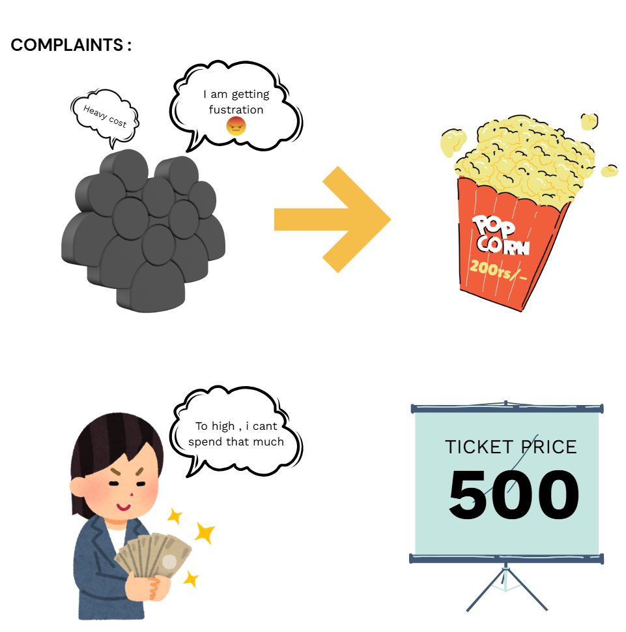
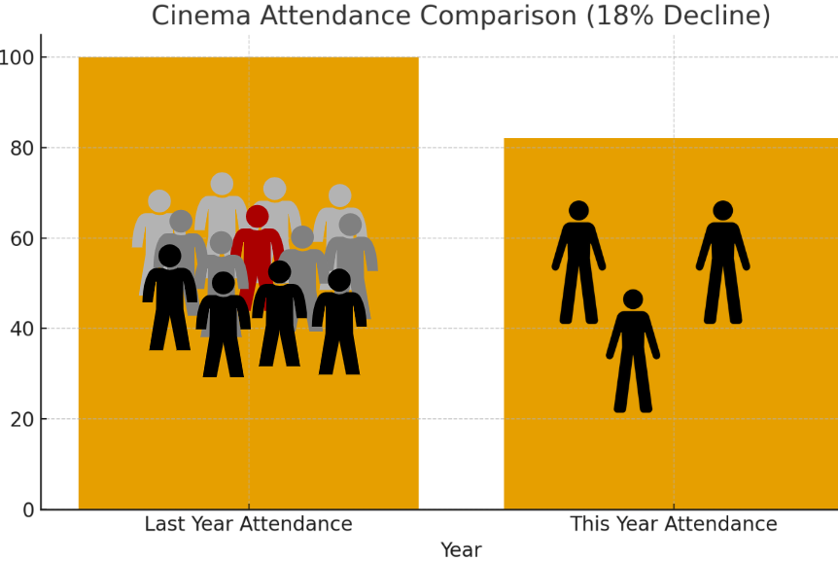
1. Identify the problem

Slide 5
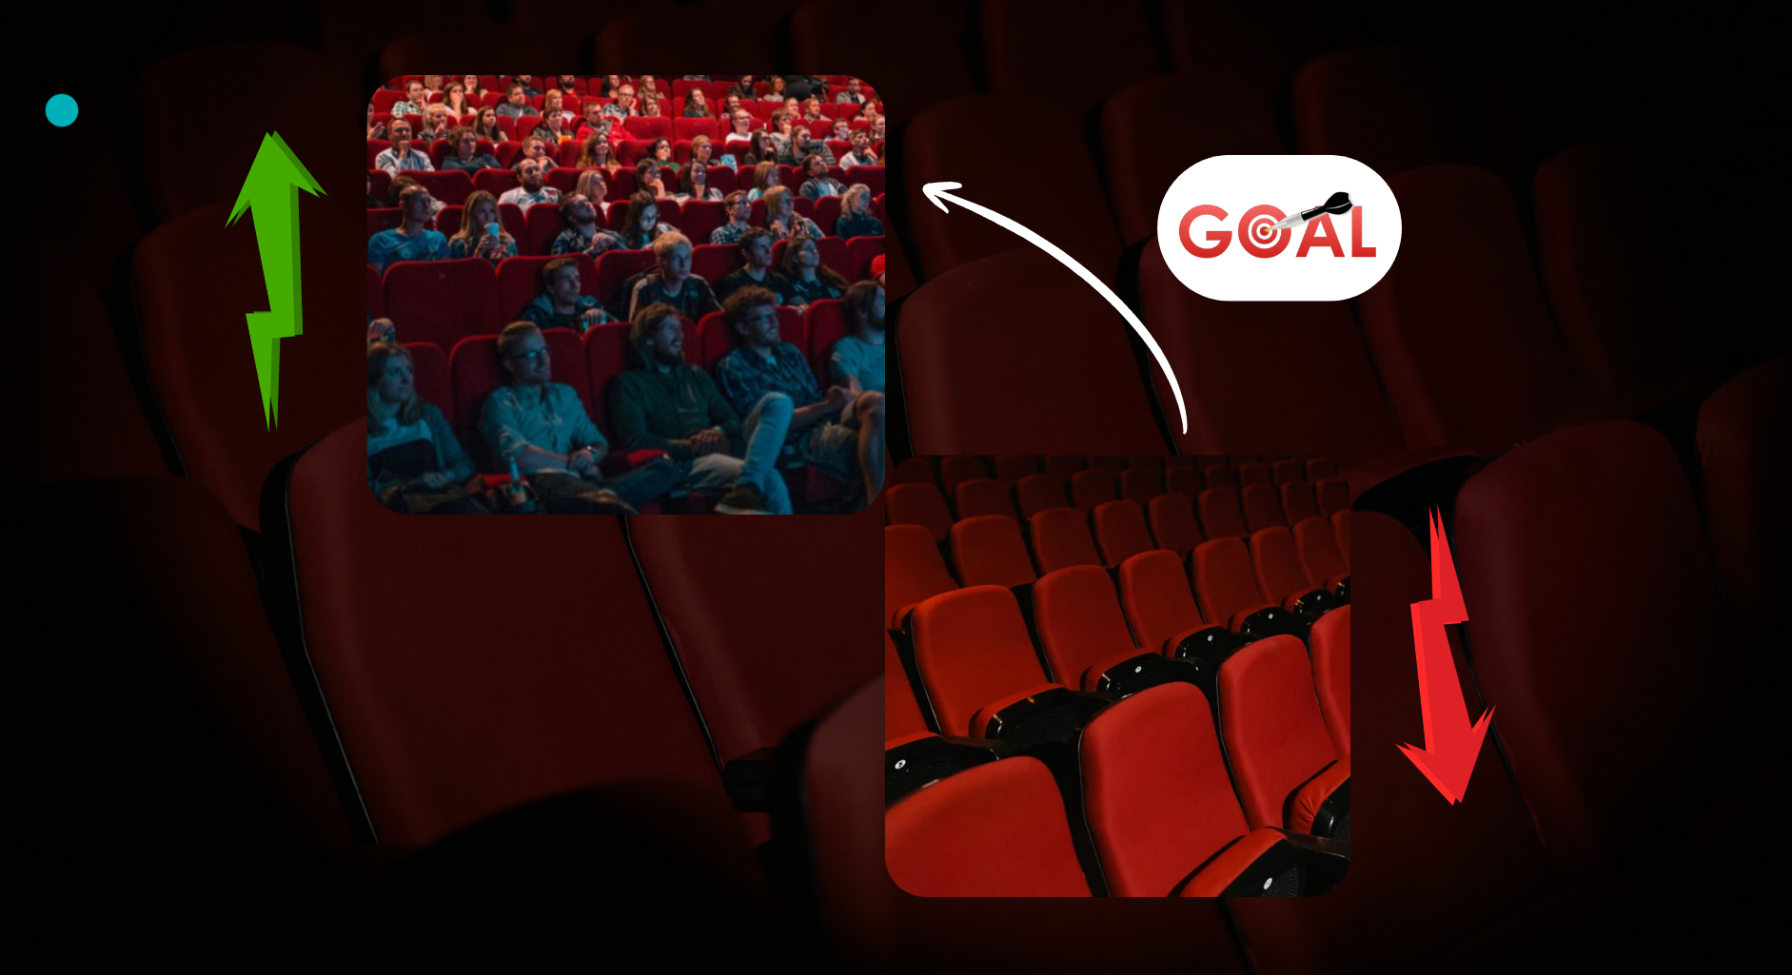
Increasing attendance by 15% , Improve in theatre spending time by 20% and reducing waiting time to by snacks

Slide 6
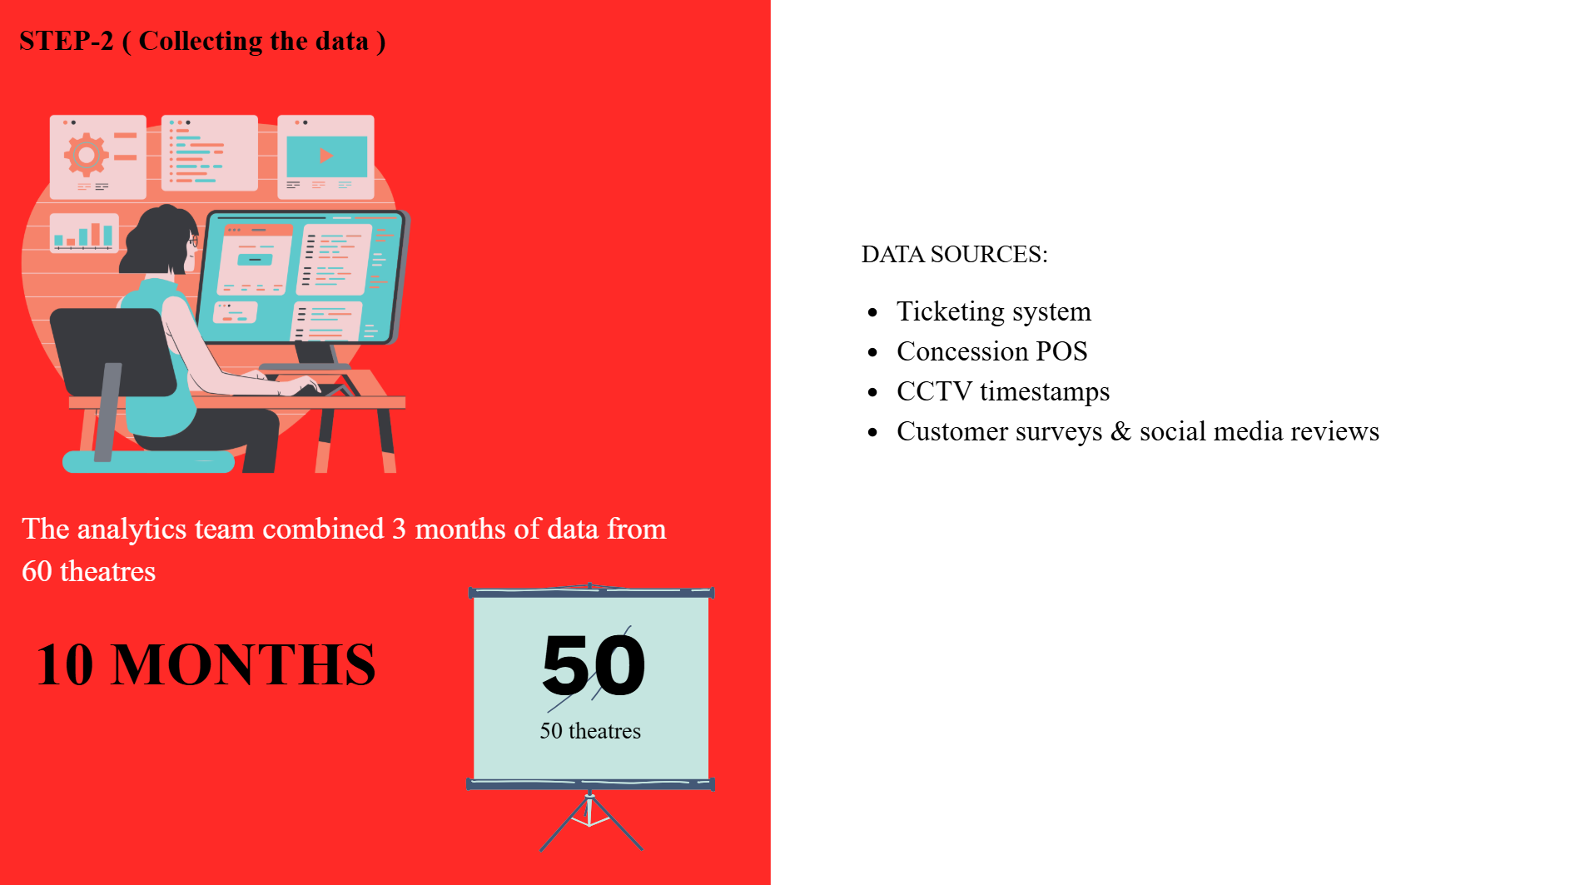

Slide 7
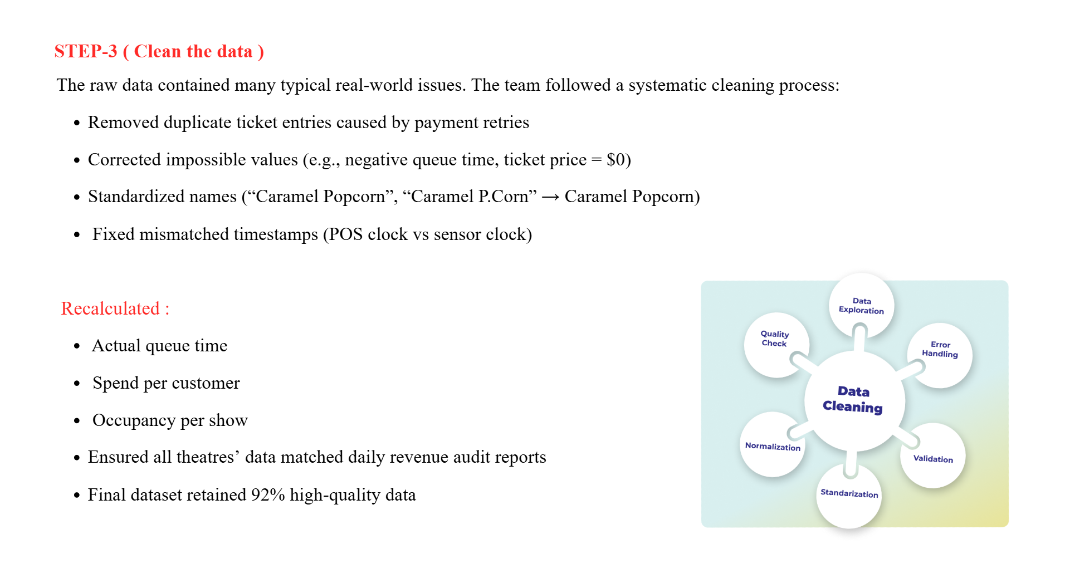

Slide 8
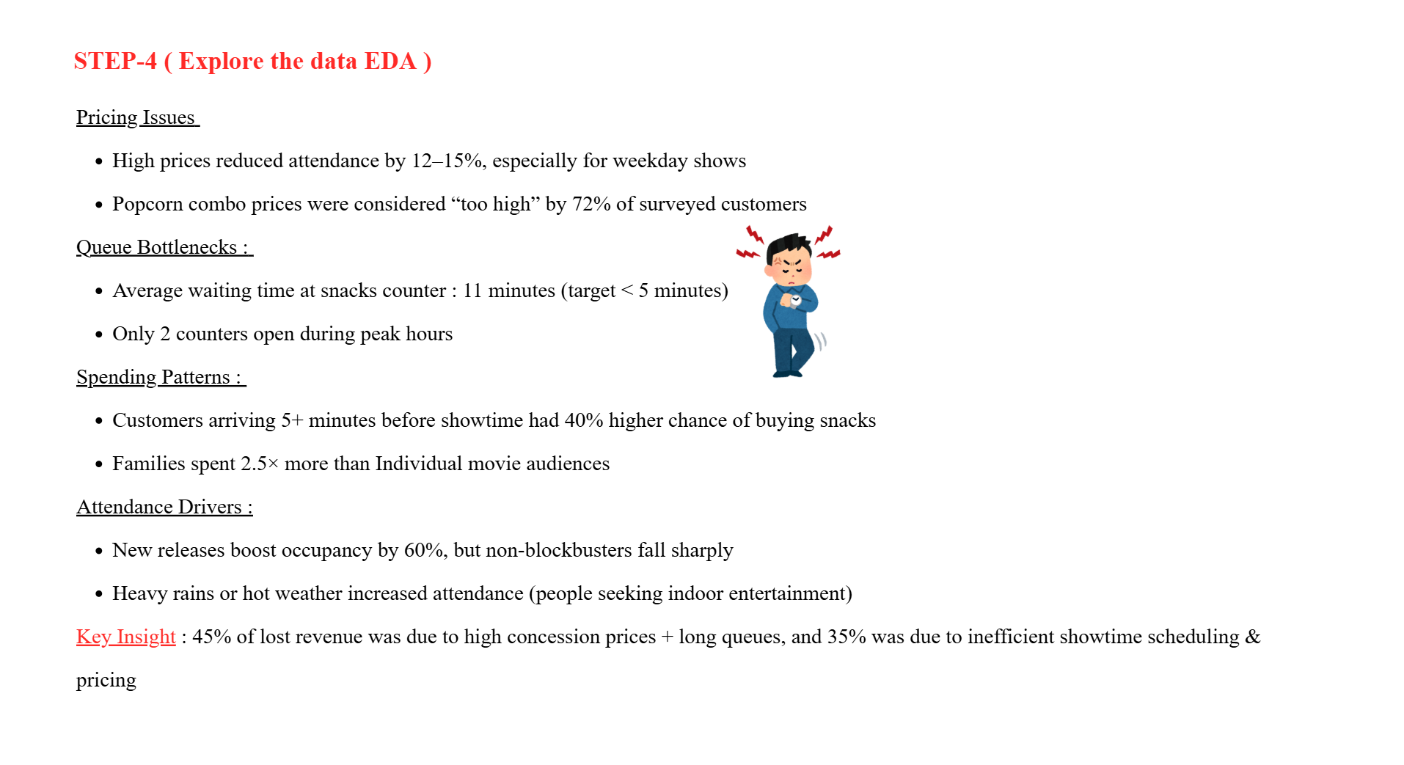
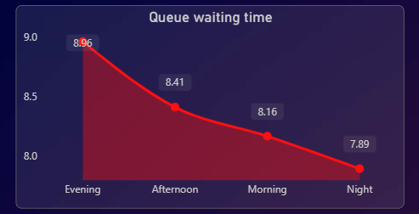
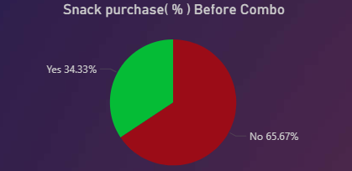

Slide 9
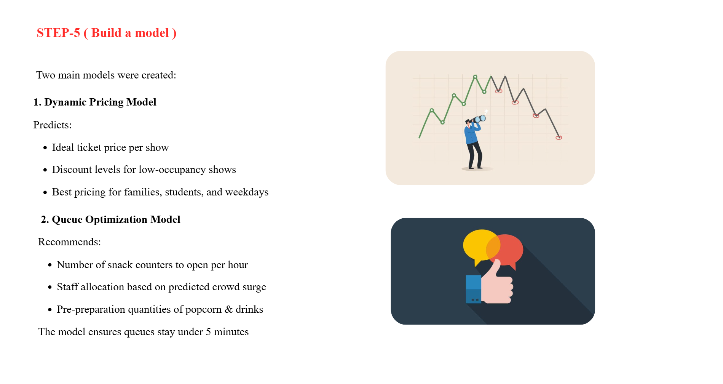

Slide 10
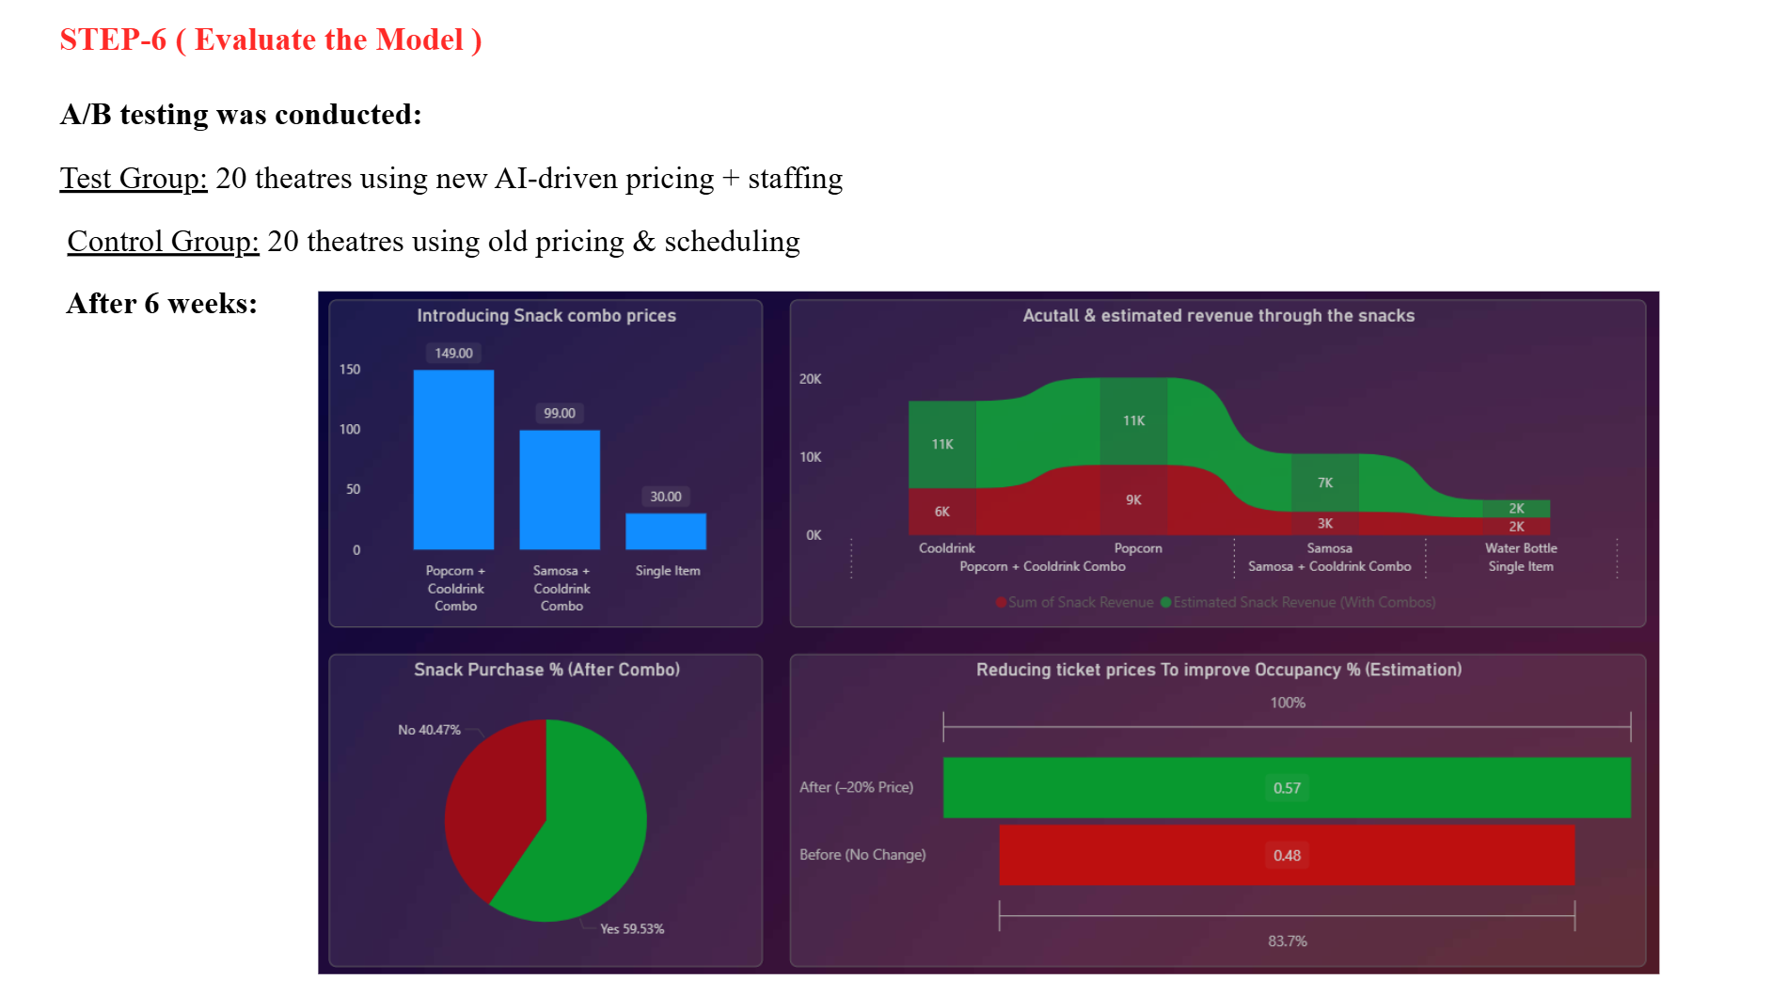

Slide 11
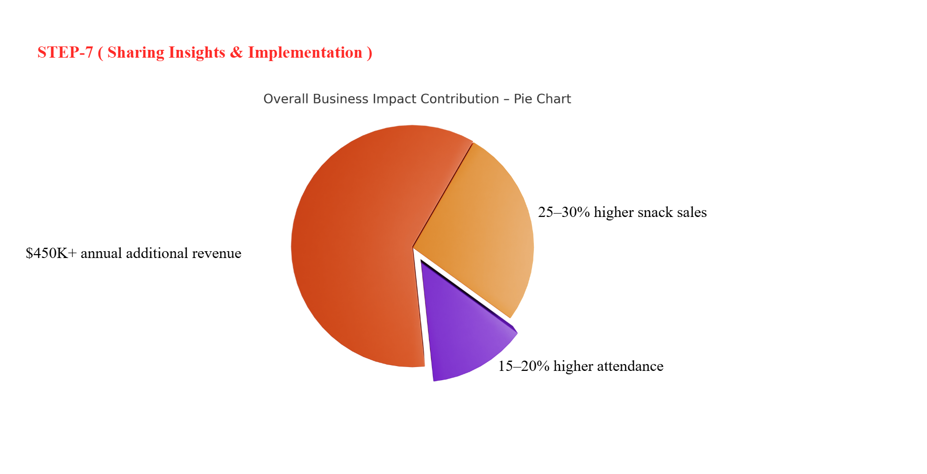

Slide 12


